Slide 1
CSIII Final Project
Andrew Liu

Slide 2
Plans
Creating a word game, similar to Wordament, Scramble with Friends, Boggle etc.
However, all the words made must be correct, or else the game ends
To make the game easier, tiles can be reused

Slide 3
Expectations
Difficulties:
Learning GUI
  paintComponent(Graphics g)
Listeners
  MouseListener
  MouseMotionListener

Slide 4
Expectations
Easy things:
Drawing the display
Checking words with a dictionary
Highlighting tiles
Things to learn:
GUI
Using Listeners

Slide 5
GUI
paintComponent(Graphics g)
Called by system
repaint()
MouseListener
5 methods
  MousePressed(Event evt)
  MouseReleased(Event evt)
  MouseClicked(Event evt)
  MouseEntered(Event evt)
  MouseExited(Event evt)

Slide 6
GUI
MouseMotionListener
2 methods
  MouseDragged(Event evt)
  MouseMoved(Event evt)

Slide 7
GUI
MouseListener and MouseMotionListener
A class must implement it
All the methods must be present
getX()
getY()

Slide 8
Design
Classes:
  WordGame
    Creates the window
    Paints the content
  Grid
    Manages tiles, character values, etc.
  Tile
    Handles Events

Slide 9
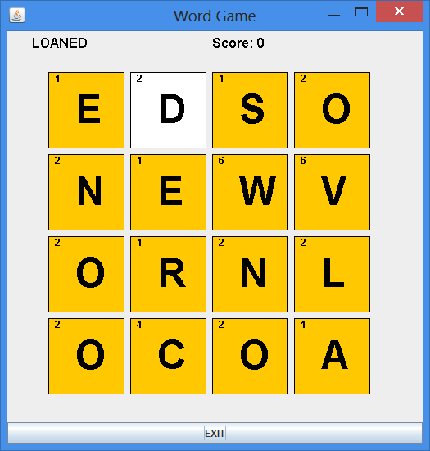
Demo

Slide 10
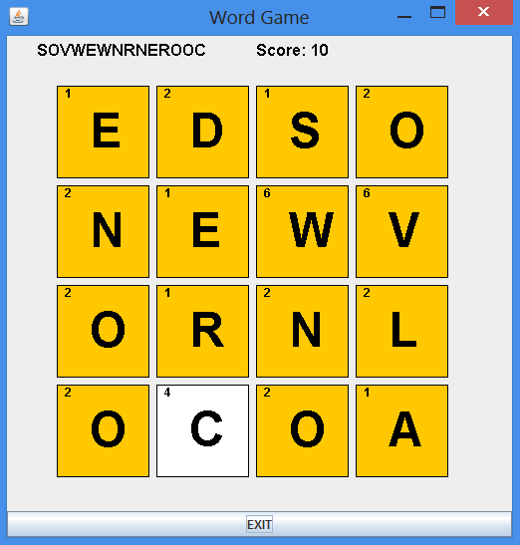
Demo

Slide 11
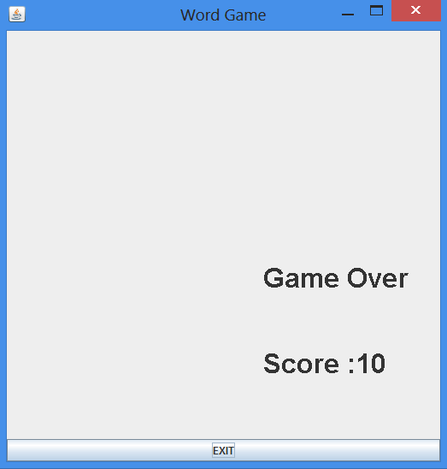
Demo

Slide 12
Results
The word game works as I had planned, however:
  It is extremely difficult to get a high score
  There aren’t as many variables as I would have liked
Challenges
  Little details which require thorough thinking
  Highlighting tiles

Slide 13
Future work
Adding in more variables
  Time
  Number of wrong words allowed
A different scoring method
Making dragging diagonally easier

Slide 14
Sources
The textbook – Building Java Programs
http://math.hws.edu/javanotes/c6/

